Slide 1

MIPS Addressing Model
This presentation will introduce the MIPS addressing model, a fundamental concept in computer architecture. We'll explore different addressing modes and their uses in accessing memory locations.
by Harish Duraikannan
HD

Slide 2
Memory Organization in MIPS
Memory Layout
Addressing Modes
MIPS architecture has a byte-addressable memory space, meaning each byte has a unique address.
MIPS uses multiple addressing modes to access data in memory, including immediate, register, base, and PC-relative addressing.

Slide 3
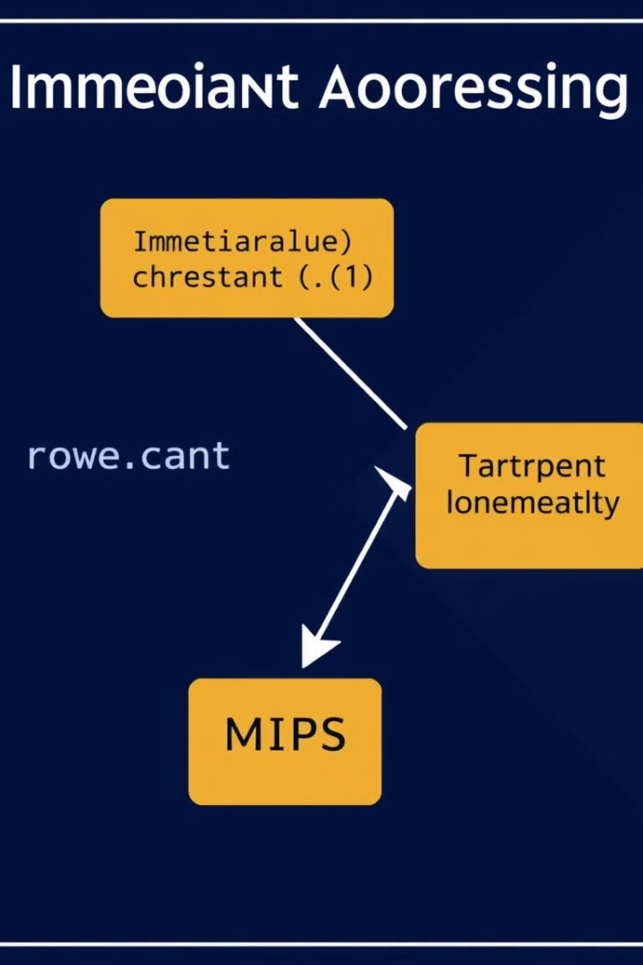
Immediate Addressing
1
Constant Value
2
Efficiency
The instruction directly incorporates a constant value to be used in the operation.
It's efficient for simple operations, such as adding a constant to a register value.

Slide 4
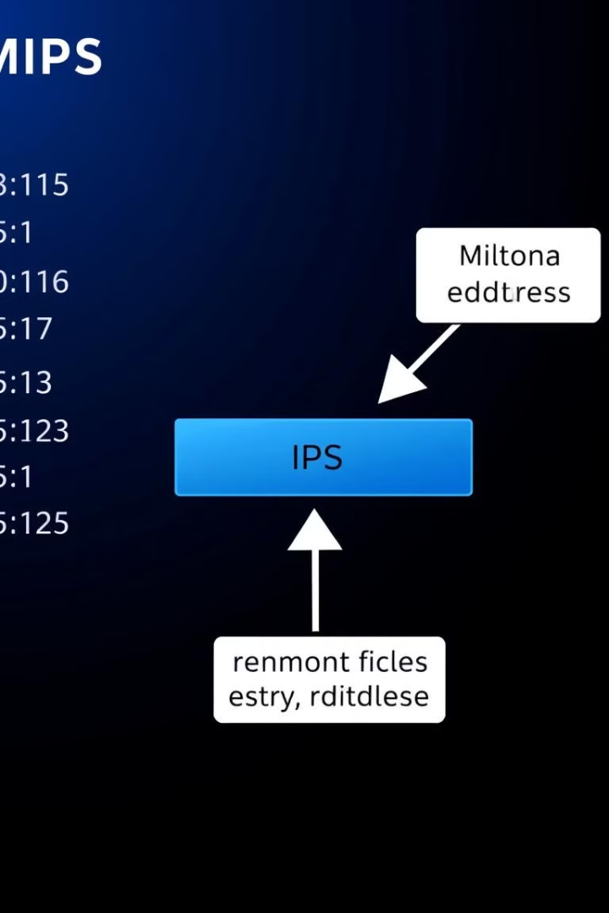
Register Addressing
Feature
Description
Register
The memory address is stored in a register.
Flexibility
Allows dynamic addressing, where the address can be changed during program execution.
Speed
Accessing data through registers is very fast, as registers are located within the CPU.

Slide 5
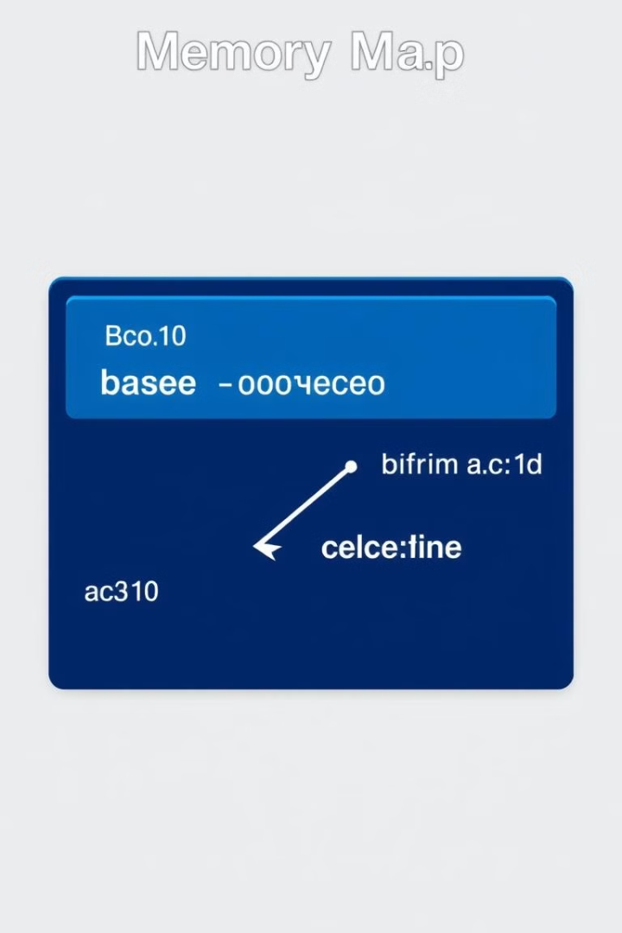



Base Addressing
Base Register
An instruction specifies a base register containing a starting address.
Offset
An offset value is added to the base address to calculate the target memory address.
Flexibility
Allows accessing data within a specific memory region by adjusting the offset.

Slide 6

PC-Relative Addressing
Data Access
Program Counter (PC)
This mode allows for accessing data located close to the current instruction.
The PC holds the address of the currently executing instruction.
1
2
3
Offset
An offset value is calculated relative to the PC to find the target address.

Slide 7
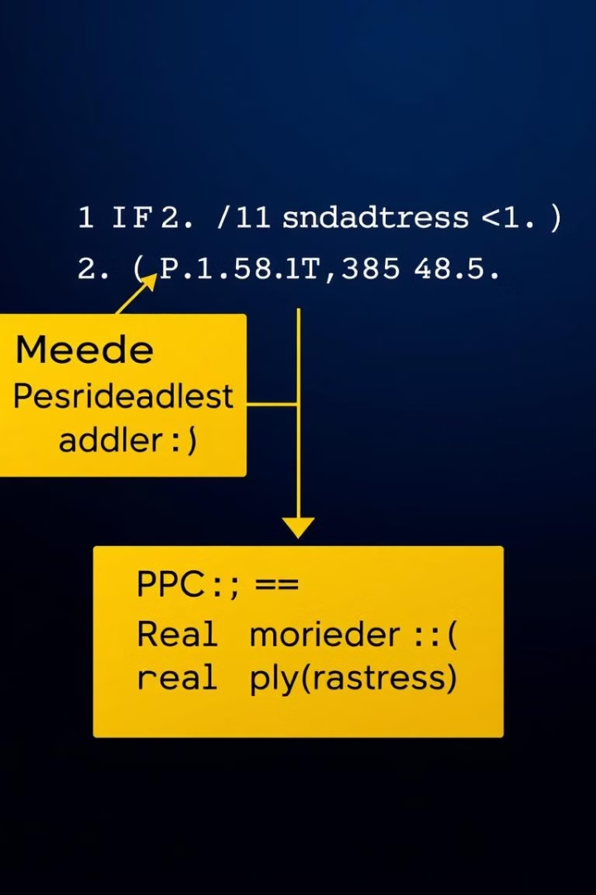
Pseudodirect Addressing
High-Level Abstraction
Calculation
The final memory address is calculated based on the pseudodirect address and the PC's value.
MIPS allows using a 26-bit address field, making it appear like a direct address, but it's actually a pseudodirect address.
Code Optimization
This approach optimizes code size and execution speed by utilizing a shorter address field.

Slide 8




Conclusion and Key Takeaways
Memory Organization
Understanding MIPS memory organization is crucial for effective memory management and program execution.
Addressing Modes
MIPS uses a variety of addressing modes to access data in memory, each offering distinct advantages.
Program Design
Knowing how addressing modes work helps programmers design efficient and effective code.

Slide 9

Thank You
Presentation by Harish D.

